Slide 1
Introduction to Electrostatics
Applied Physics
Farhan Ahmed

Slide 2
Applied Physics
Applied physics is the application of physics to solve scientific or engineering problems.
It is usually considered a bridge or a connection between physics and engineering.
Applied physics is rooted in the fundamental truths and basic concepts of the physical sciences.
Utilization of scientific principles in practical devices and systems and with the application of physics in other areas of science and technology.

Slide 3
Applied Physics
Course Learning Outcomes (CLO)
1 To learn the basic knowledge of fundamentals of Physics.
2 To apply the applications concepts of Physics in the real world.
Text Book
1. Fundamental of Physics, by Halliday, Resnick and John Walker (8 th edition)
Reference Material
Electronic Devices, by Thomas Floyd

Slide 4
What is Electrostatics
Electrostatics
Electric Charge
At Rest
It is a branch of physics in which we deal with the properties of electric charge when the charge at rest.
The study of electromagnetic phenomena that occur when there are no moving charges.

Slide 5
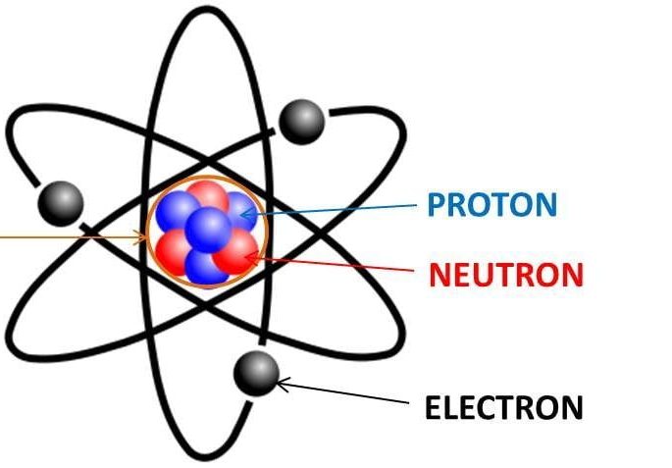
What is Electric Charge
Electric charge (symbol q, sometimes Q) is the physical property of matter that causes it to experience a electric force between various object.
Electric charge can be positive or negative.
Like charges repel each other and unlike charges attract each other.

Slide 6
What is Electric Charge
We can divide our discussion about charge into static electricity phenomena and electric current.
Static electricity refers to charge that doesn't move unless "triggered" to do so.
A common example you've experienced is getting a shock when you touch something metal, usually in the winter when the air is dry

Slide 7
What is Electricity
Electricity is the flow of electrical energy caused by the movement of tiny particles called electrons.
These charged particles simply release electrical energy when they move in a particular way.
Every atom has three basic component parts:
Protons — Positively charged particles
Neutrons — Particles with no charge
Electrons — Negatively charged particles

Slide 8
What is Electricity
The protons and neutrons stay in the centre of the atom.
The electrons orbit around the nucleus.

Slide 9
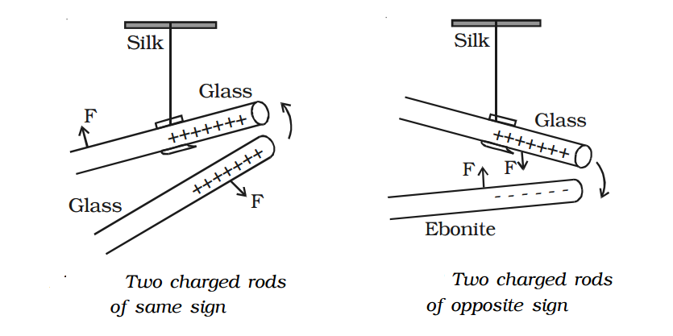
Frictional Electricity
The electricity (i.e. transfer of electrons) that is produced due to friction is called frictional electricity.
When we rub two neutral bodies, there will be some transfer of electrons from one body to the other due to structural modifications because of the frictional forces acting on them

Slide 10
Frictional Electricity
Electrons in glass are loosely bound in it than the electrons in silk.
When glass and silk are rubbed together, the comparatively loosely bound electron from glass get transferred to silk.
As a result , glass become positively charged and silk become negatively charge.

Slide 11
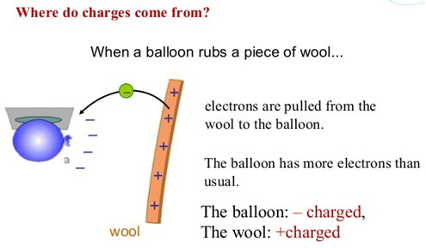
How is frictional electrification caused
When a body is rubbed with another, due to friction, some electrons from one body gets transferred to the other body.
If the electrons are transferred from a body , then the deficiency of electron makes the body positive.
If the electrons are gained by a body , then the excess of electrons makes the body negative.

Slide 12
How is frictional electrification caused
When a body is rubbed with another, due to friction, some electrons from one body gets transferred to the other body.
If the electrons are transferred from a body , then the deficiency of electron makes the body positive.
If the electrons are gained by a body , then the excess of electrons makes the body negative.

